Slide 1
The Facebook Assignment

Slide 2
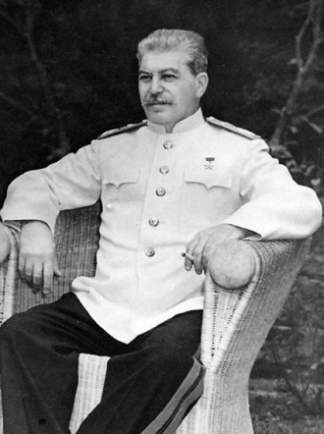
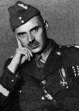
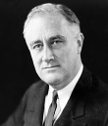
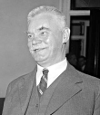
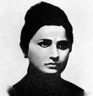
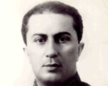
facebook
Wall
Photos
Flair
Boxes
Joseph Stalin
Logout
Joseph Stalin I really want that Nobel Peace Prize.
Wall
Info
Photos
Boxes
Write something…
Share
View photos of Joseph Stalin (5)
Send Joseph Stalin a message
Joseph Stalin the rumors are true, Hitler and his wife have committed suicide, the war shall be ours now!
April 30, 1945
Poke Joseph Stalin
Wladislav Rieger I nominated you for the Nobel Peace Prize!
February 8, 1948
Information
Networks:
Soviet Union
Birthday:
December 18, 1878
Political:
Communist Party Of the Soviet Union
Religion:
Atheist
Hometown:
Gori, Georgia
Joseph Stalin to all British diplomats, I would like two agreements: a mutual assistance/aid pact and recognition that after the war the Soviet Union will gain land!
September 2, 1941
Joseph Stalin Hitler you are going to regret breaking that non-aggression pact with me! Mark my words you will pay for it!
June 22, 1941
Friends
Joseph Stalin the Red Army has now officially invaded Eastern Poland!
September 17, 1939
Frank
Wladis
Adolf Hitler signed a non-aggression pact with the Soviet Union and Stalin today!
August 23, 1939
Halvden
Ekat
Yakov

Slide 3
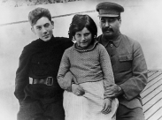
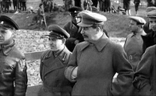
facebook
Wall
Photos
Flair
Boxes
Joseph Stalin
Logout
Joseph Stalin
Wall
Info
Photos
Boxes
Basic Information
Networks: Soviet Union
Sex: Male
Birthday: December 18, 1878
Hometown: Gori, Georgia
Relationship Status: Married
Political Views: Communist Party of the Soviet Union
Religious Views: Atheist
View photos of Joseph Stalin (5)
Send Joseph Stalin a message
Poke Joseph Stalin
Personal Information
Information
Activities: Commanding the Army, promoting communism, Soccer
Interests: Controlling the Soviet Union, Music
Favorite Music: Led Zepplin, The Beatles
Favorite Movies: District 9, The Avengers, Hurt Locker
Favorite TV Shows: How I met your mother, Family Guy, The Simpsons
Favorite Books: Brothers and Sisters, Face to Face, Jamilya
Networks:
Soviet Union
Birthday:
December 18, 1878
Political:
Communist Party of the Soviet Union
Religion:
Atheist
Hometown:
Gori, Georgia
Photos
Contact Information
2 Albums
Address: 1 Soviet Lane, Moscow, Russia
Phone Number: 1-800-120-9000
The Family
Updated last Tuesday
Industrialization
Updated two months ago

Slide 4
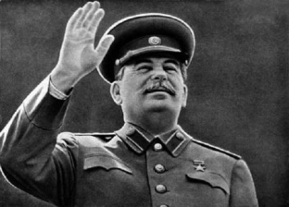
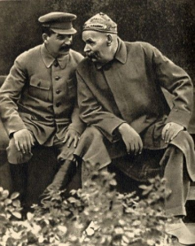
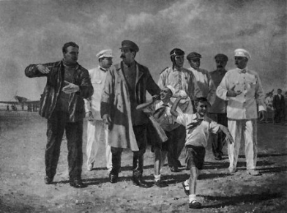
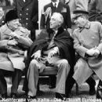
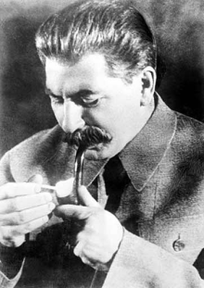
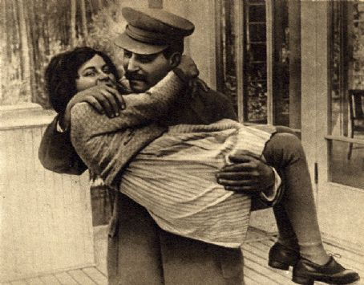
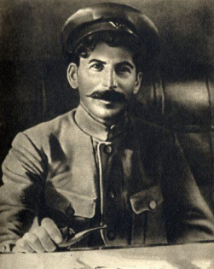
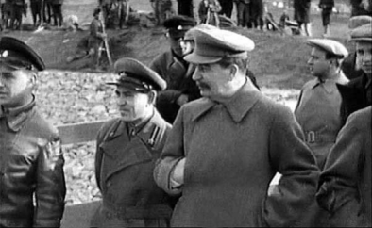
facebook
Wall
Photos
Flair
Boxes
Joseph Stalin
Logout
Joseph Stalin
Wall
Info
Photos
Boxes
Photos of Joseph Stalin 7 Photos
Joseph Stalin’s Albums 2 Photo Alums
The Family
5 photos
Industrialization
5 photos
Profile Pictures
1 photo

Slide 5
Possible topics
http://www.thecanadianencyclopedia.ca/en/article/rebellions-of-1837/
Church
http://www.canadiana.ca/citm/themes/constitution/constitution10_e.html
Louis joseph Papineau
https://www.collectionscanada.gc.ca/confederation/023001-4000.58-e.html
Wolfred Nelson
http://www.biographi.ca/en/bio/nelson_wolfred_9E.html
The Gevenor John Colborne
http://www.thecanadianencyclopedia.ca/en/article/sir-john-colborne-1st-baron-seaton/

Slide 6
Bibliography
Your facebook requires a bibliography
http://www.bibme.org/

Slide 7
facebook
Wall
Photos
Flair
Boxes
Joseph Stalin
Logout
Joseph Stalin I really want that Nobel Peace Prize.
Wall
Info
Photos
Boxes
Write something…
Share
View photos of Joseph Stalin (5)
Send Joseph Stalin a message
Name ____________ _______________________________________
________________ date_____________
Poke Joseph Stalin
Name ____________ _______________________________________
________________ date_____________
Information
Networks:
Birthday:
Political:
Religion:
Hometown:
Name ____________ _______________________________________
________________ date_____________
Name ____________ _______________________________________
_______________________________________________________________________
_________________________date_____________
Friends
Name ____________ _______________________________________
_______________________________________________________________________
_________________________date_____________
Frank
Wladis
Name ____________ _______________________________________
_______________________________________________________________________
_________________________date_____________
Halvden
Ekat
Yakov

Slide 8
facebook
Wall
Photos
Flair
Boxes
Joseph Stalin
Logout
Joseph Stalin
Wall
Info
Photos
Boxes
Basic Information
Networks:
Sex:
Birthday:
Hometown:
Relationship Status:
Political Views:
Religious Views:
View photos of Joseph Stalin (5)
Send Joseph Stalin a message
Poke Joseph Stalin
Personal Information
Information
Activities:
Interests:
Favorite Music:
Favorite Movies:
Favorite TV Shows:
Favorite Books:
Networks:
Birthday:
Political:
Religion:
Hometown:
Photos
Contact Information
2 Albums
Address:
Phone Number:
The Family
Updated last Tuesday
Industrialization
Updated two months ago

Slide 9
facebook
Wall
Photos
Flair
Boxes
Joseph Stalin
Logout
Joseph Stalin
Wall
Info
Photos
Boxes
Photos of Joseph Stalin 7 Photos
Joseph Stalin’s Albums 2 Photo Alums
The Family
5 photos
Industrialization
5 photos
Profile Pictures
1 photo

