Slide 1
Second phase of industrialization

Slide 2
1900-1929
The second phase of industrialization in Canada was characterized by a rapid expansion of industries that developed because of new sources of energy: hydroelectricity and oil

Slide 3
Staying competitive
To be competitive, Canadian industries had to compete with American and British industries.
They had to keep their costs low.
To lower production costs, they built factories close to the source of material (near forests, mines)
Development of railways allowed the products to be distributed at a lower cost.

Slide 4
Economic factors leading to industrialization
There were 3 conditions that enabled the Dominion to get enough capital to ensure economic growth during 2nd phase of industrialization:
Wheat
Foreign investment
First World War

Slide 5
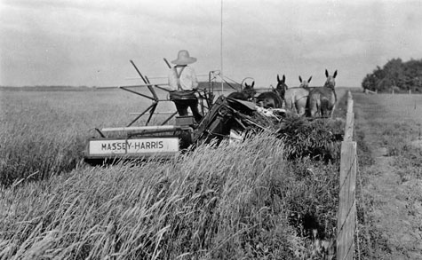
Wheat
Early 1900s, cultivation of wheat (in the West) expanded quickly
Wheat became a primary export
The increase in cultivation and the price of grain led to Montreal experiencing major growth. It was a hub between fertile land in the West and the foreign market (USA)

Slide 6
Foreign investment
Government wanted investors from Great Britain or the USA
Anyone wanting to invest in natural resources sector got privileges (less taxes, good return on investment)
The supply of foreign capital let to modernization of industrial infrastructures (factories, transport networks) and creation of jobs

Slide 7
First World War
WWI lasted from 1914-1918
Canada’s participation in the was stimulated the economy
Canada was a major supplier for the allied troops
Mining, iron and steel, clothing industries all grew
Agriculture benefited as there was more demand for wheat and pork

Slide 8
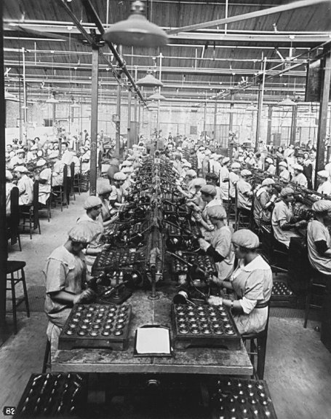
WWI
Factories were modernized in order to meet the demand for products for the soldiers

Slide 9
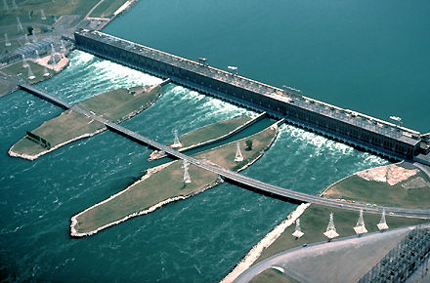
Hydroelectricity
Having many waterways, Quebec used this resource and developed hydroelectricity.
The electricity was then directed to cities where factories were located.

Slide 10
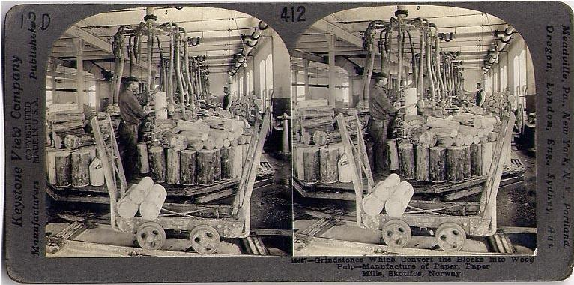
Pulp and paper
Large quantities of wood necessary for production of pulp and the American demand for newsprint paper explain the growth of the pulp and paper industry.
In the early 20th century, 80% of North America’s paper came from Canada.

Slide 11
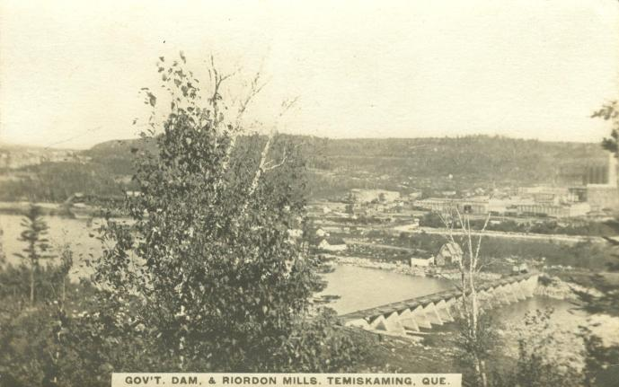
Pulp mills
Pulp mills were set up with their own hydroelectric facilities
For example on the Rivière Saint-Maurice or the Saguenay River

Slide 12
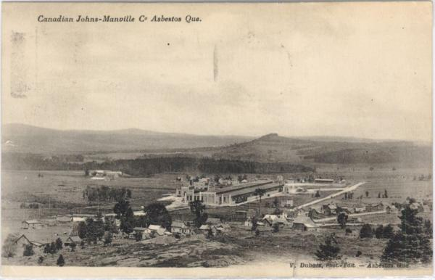
Mining
During 2nd phase of industrialization, mining developed rapidly.
Mineral resources attracted foreign investors who set up factories in Quebec.
Zinc, copper, nickel, gold, asbestos, and cobalt were commonly mined.

Slide 13
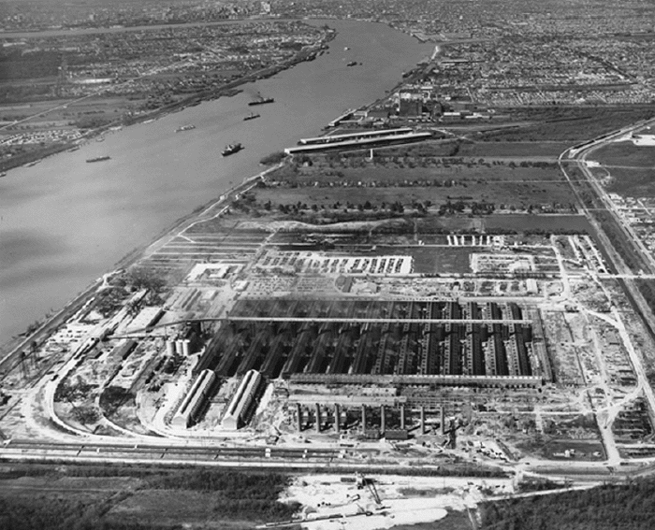
Aluminum
The production of aluminum from bauxite requires a lot of electricity.
Due to the availability of hydroelectricity, many aluminum smelters were established in Quebec.
Aluminum was used for transport and building materials, electric components..

Slide 14
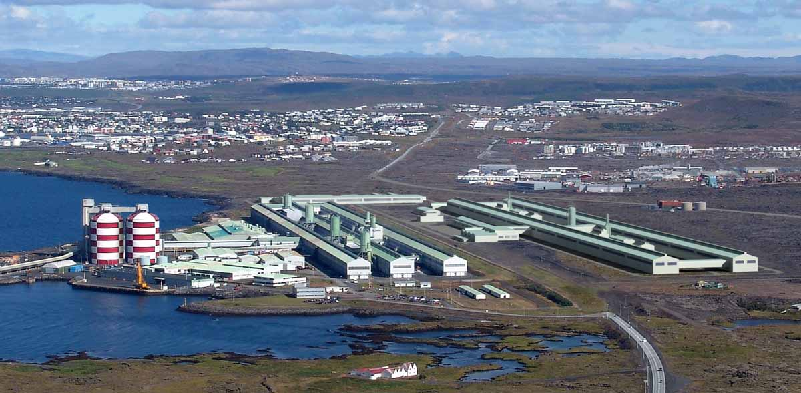
The Northern Aluminum Company established itself in Shawinigan in 1902.
It changed its name to Alcan in 1945

Slide 15
Iron and steel
Iron and steel sector grew rapidly due to increase in production of transport equipment
Also due to making appliances like sewing machines, cash registers, and typewriters
Iron and steel paved the way for the automobile industry

Slide 16
Electricity in the cities
Electricity powered the streetcar networks
Getting around the city became easier, and cost decreased
People no longer needed to live within walking distance of work.
Cities started to expand, encroaching on agricultural land
Electricity offered greater comfort to wealthy residents

Slide 17
