Slide 1
After the Constitutional Act of 1791

Slide 2
Canada a people’s history
Canada a people history episode 5 - 49 mins - 59
Why did Canadiens and British loyalists want to divide the land? What was the result?
Who were the other groups moving up to Canada other than the loyalist? Why was this a problem?
What was the second great revolution that occurred in the 18th century and in which country did it occur?
What opinion did the English Canadians have of the French Canadiens?

Slide 3
Canada a people’s history
Canada a people history episode 5 - 49 mins - 59
Why did Canadiens and British loyalists want to divide the land? What was the result?
Because their ideas about government and governing were so different they needed separate territories and governments.
Who were the other groups moving up to Canada other than the loyalist? Why was this a problem?
Other Americans unhappy with the USA came up to Canada. They outnumbered the british 4/1.
What was the second great revolution that occurred in the 18th century and in which country did it occur?
French revolution.
What opinion did the English Canadians have of the French Canadiens?
The English Canadians wanted to de-frenchify.
They would be happy to ship them off to France.
Unhappy that they were under catholic rule.

Slide 4
Today’s objectives
By the end of this class you will be able to tell who the different parties were in Canada in the early 1800’s
Explain to me how a law is passed
What is the difference between representative and responsible representative government.

Slide 5
Analysis of parties in upper and lower canada
Party names | Relationship to the government | Beliefs and policies | membership

Slide 6
The issues in upper and lower canada
Look in booklet and textbook

Slide 7
Ranking ladderof those issues
issues | importance

Slide 8
Analysis of parties in upper and lower Canada
Party names | Relationship to the government | Beliefs and policies | membership
British party( Tories) | They supported the British government in Canada | They preferred tradition and stability were suspicious of any major changes | You had to be apart of the elite of society Not anyone could join.
Parti Canadiens( Reformers) Made up of both reformers and radicals | They support the British government but thought the colonies could handle more responsibility | They believed in responsible and representative government | They were not apart of the elite they were a mixture of French Canadian and Irish Canadians
 | Radicals disliked the government they would eventually rebel | They wanted change to happen quickly . They wanted to create new society like in the US

Slide 9
The issues in upper and lower canada
Upper Canada and the British party
Lower Canada and the Parti Canadien
Political violence
Language
Taxes
Roads vs canals
British immigration
Weakening economy
Family compact
Chateau clique
Land
Against because they lost much of there homeland and the British did not respect the catholic religion
For because they want to increase there population.
Agricultural crisis

Slide 10
Ranking ladderof those issues
issues | importance
British immigration | Because the more British people there are the bigger influence they have on the government
Family compact | These rich folks began receiving positions of power so could have a say in political issues
Roads and canals | The way that people transport their goods in important.
Taxes | The way the country would receive their financial power in order to build prisons.

Slide 11
What made the situation in lower Canada more dangerous than in Upper Canada?
The situation in lower canada was more dangerous was because there were two opposing groups in lower canada ( french / irish against the british).

Slide 12
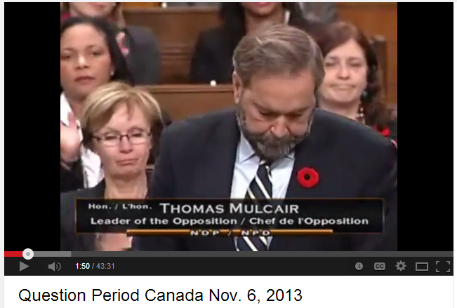
Canada’s Legislative Assembly
http://www.youtube.com/watch?v=Y_ovl-1VlLA
After watching a session of question and answer period, what do you notice about the questions that they are asking?

Slide 13
Parliamentary procedures
You will choose a leader in each of your groups.
In each of your parties you will have 20 mins to prepare your bill arguments, rebuttals, and closing.
You will decide you will present which argument.
2 bills by the Tories
2 bills by the Reformers
We will then vote by standing ( either for or against)

Slide 14
Debrief
How did this legislative assembly debate make you feel?
You have only been doing this for 30 minutes, how do you think you might feel after doing it for 30 years?

Slide 15
Debrief
1.What was most frustrating about the Mock legislative assembly of lower Canada?
2. What do you think the Canadien Reformers found frustrating?
3. What do you think the British Tories found the most frustrating ?
4. What are some possible solutions to these problems? What are some of the consequences that result from these problems?

Slide 16
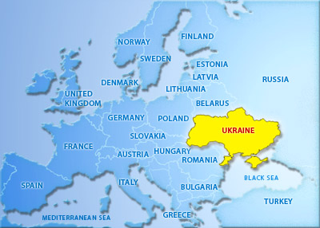
The Ukraine today

Slide 17
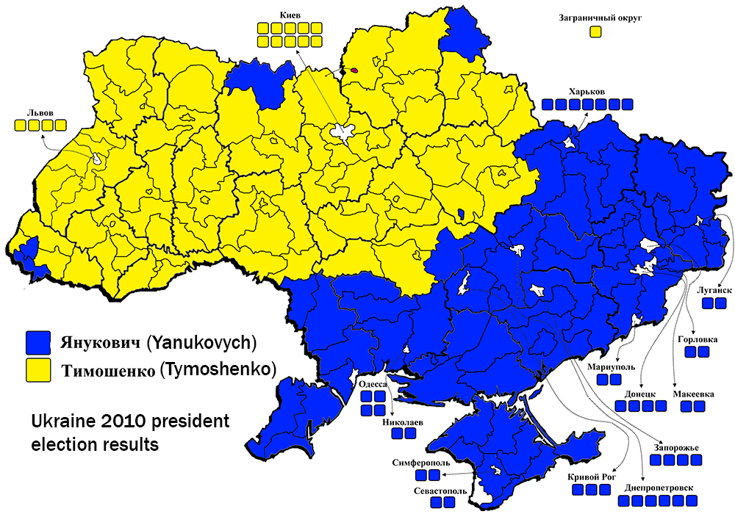
The Ukraine today
Liberal and closer with Europe
Conservative and closer to communist Russia

Slide 18
Parliament: Battle and the Press
Battles:
Choosing the speaker of the house (first was a Canadiens choice). Speaker's duty is to interpret rules impartially, to maintain order, and to defend the rights and privileges of Members, including the right to freedom of speech.
Language: Canadiens wanted bilingualism, Britain agreed only to have laws translated.

Slide 19
Parliament: Battle and the Press
In 1805, disagreement about financing prisons – created to parties – Parti canadien, and British Party.
Newspapers became very important during this time period – members of the assembly used them to spread their ideas and political demands.
The Quebec Mercury – British
Le Canadien - French

Slide 20
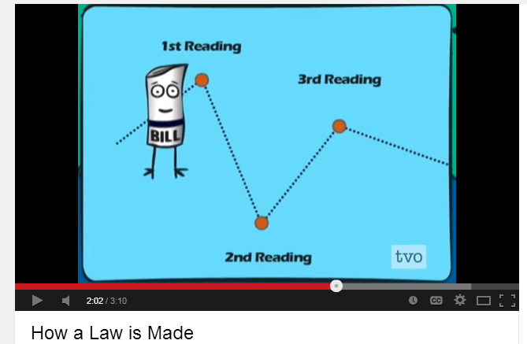
How is a bill passed?
Answer the following questions :
Why is it so difficult to pass a bill?
Who has to agree on a bill before it’s passed?
http://www.youtube.com/watch?v=yzflLqk0ksM

Slide 21
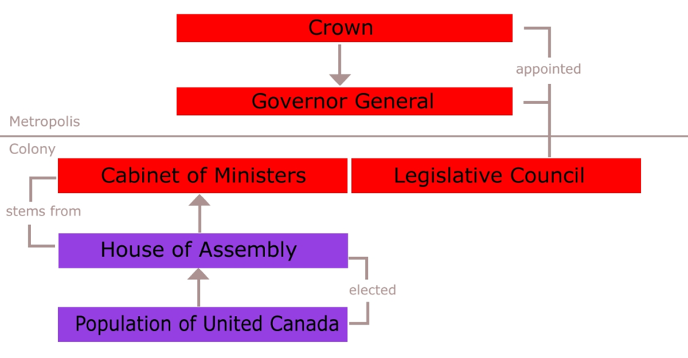
What is Responsible vs Representative Government ?
Representative government
Responsible government
Look at the following two diagrams can you see the differences?

Slide 22
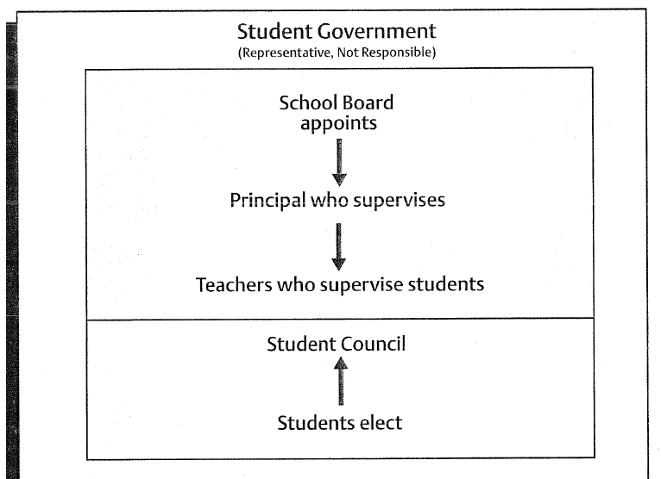
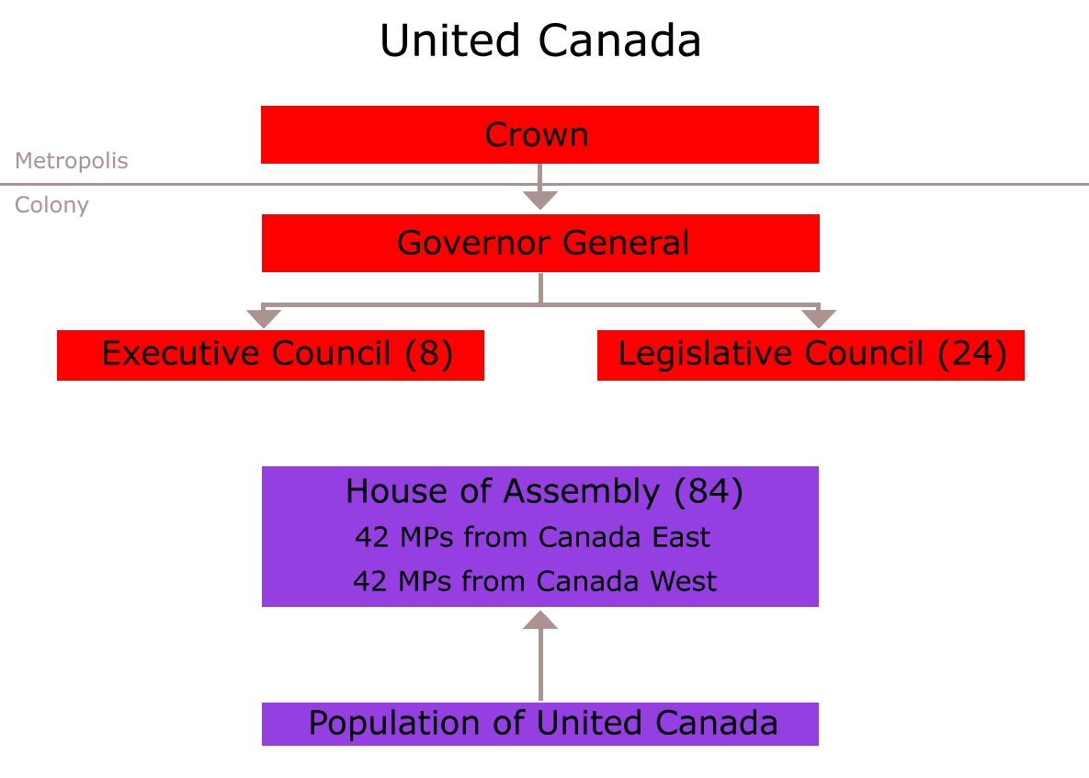
Representative Government ?

Slide 23
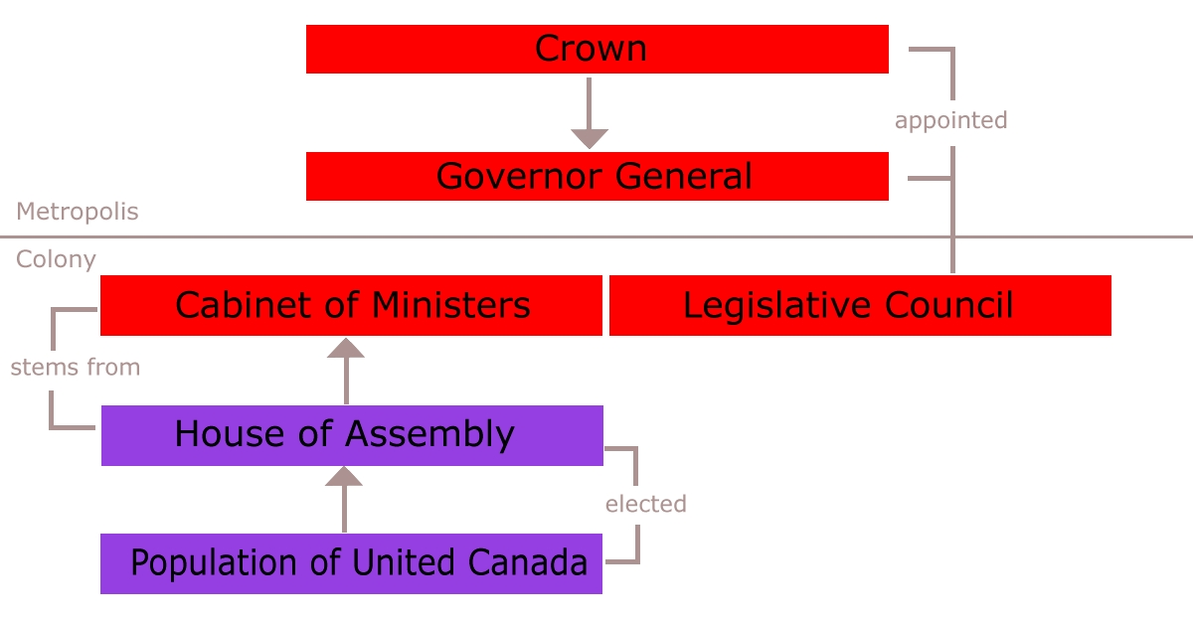
Responsible Government

Slide 24
Now change this into Responsible Government

Slide 25
Definitions
Representative government : is a system where people elect representatives to represent their needs and interests.
Responsible government :refers to a system in which the government is responsible to the elected representatives of the people.

Slide 26
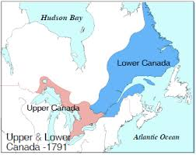
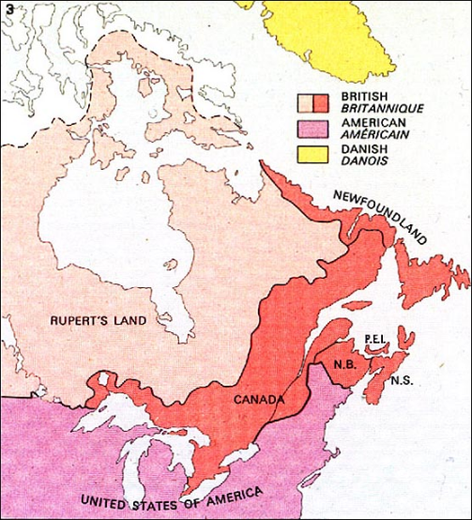
Moving towards confrontation**
1822- Petition by Upper Canada to unite both Upper(British) and Lower( Canadiens) colonies.
Lower Canada was furious at the thought
Upper Canada wanted assimilation **

Slide 27
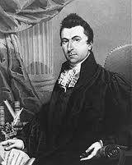
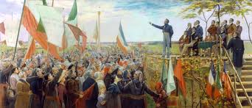
Moving towards confrontation**
1826 – the creation of the Parti Patriote – Radicals from the Parti Canadien ( reform) saw them selves as the voice of the Canadien Nation . They were lead by Louis- Joseph Papineau.
Louis- Joseph Papineau.

Slide 28
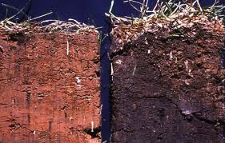
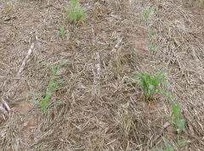
Moving towards confrontation**
1830 – 1840 Poor harvest due to depleted** soil . Now new segneuries ( Canadiens) being created only townships ( British)
Depleted soil sample

Slide 29
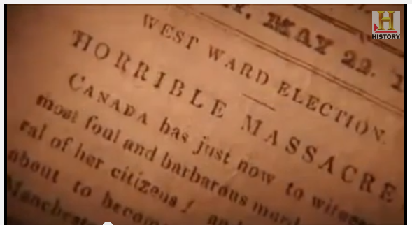
Moving towards confrontation**
The Parti Patriote wanted Responsible government so that the needs and ideas of the Canadiens people were listened to. Also to stop the British corruption of government.
However the British army was violent in dealing with political protests organized by the Parti Patriote.
This only created more tension.

Slide 30
1834 - 92 resolutions
In 1834 the Parti Partriote presented the 92 resolutions the legislative assembly which denounced corruption and demanded democracy.
Some of their demands:
Elect legislative assembly
Manage the governors budget by that legislative assembly
Protection of French language and law
Accountability of the ministers

Slide 31
Did the 92 resolutions work?
Read pg 25
What are the Russell resolutions and who created them?
They were 10 resolutions in responds to the 92 resolutions by Lord John Russell and the British Government.
How did the 92 resolutions relate to liberal ideas?7
The 92 Resolutions were based on concepts such as equality and democracy.

Slide 32
Responsible vs Representative
Poll everywhere
Representative government is when :
The ideas of the people are represented and the government has to answer to the people.
Representatives represent their own ideas and not the people’s
the ideas of the people are represented, however the government does not have to answer to the people.

Slide 33
Rebellions: video breakdown
Watch ep 7 http://www.youtube.com/watch?v=r8nFGfaXp1E
38:00 to 1:02
On The Eve of Rebellion 38:50-47:13 1837, public protests, Papineau and Mackenzie mobilize supporters
The Die is Cast 47:13-56:00 Violence in Lower Canada, Two Mountains & Richelieu Valley, British troops vs. Patriotes, Wolfred Nelson, battle at St Denis
[Transition] 56:00-56:41
The Explosion 56:46-1,06:18 Battle of St Charles, Montgomery’s Tavern, Toronto
The Last Stand 1,06:18-1,12:23 Two Mountains, St Eustache, battle in the church, Papineau exiled

Slide 34
Rebellions
Article writing
Make sure to not the who what where when and why.
What kind of hook could you use to grab your readers attention.
How did different groups react

Slide 35
Newspaper article about the Rebellions of 1837-1838

Slide 36
The 5 “W”s and 1 “H”
This is the crux of all news – you need to know six things:
Who?
What?
Where?
When?
Why?
How?
Any good news story provides answers to each of these questions.
You need to memorize this – it must become second nature!

Slide 37
Example:
If you were to cover a story about a local sports team entering a competition, you would need to know the answers to these questions:
Who are the ‘rebels’? Who is the leader? Who wins or looses? Who is affected/ dies ?
What kind of conflict occurs? What is the end result?
Where do the battles take places?
When are the battles? Are there any other important time factors?
Why are these rebellions happening? Why are these rebellions / Battles important for the canadiens, why are they important for the British fight against them?
How are the battle fought? What happens in the end?

Slide 38
The Inverted Pyramid
This refers to the style of journalism which places the most important facts at the beginning and works “down” from there.
Ideally, the first paragraph should contain enough information to give the reader a good overview of the entire story.
The rest of the article explains and expands on the beginning.

Slide 39
The Inverted Pyramid
A good approach is to assume that the story might be cut off at any point due to space limitations. Does the story work if the editor only decides to include the first two paragraphs? If not, re-arrange it so that it does.
This principal can apply to any type of medium.

Slide 40
SOME MORE TIPS… It’s About People
News stories are all about how people are affected.
In your sports story, you might spend some time focusing on one or more individuals, or on how the team morale is doing, or how the supporters are feeling.

Slide 41
Have An Angle
Most stories can be presented using a particle angle or “slant”.
This is a standard technique and isn’t necessarily bad – it can help make the purpose of the story clear and give it focus.
Examples of angles you could use for your sports story are:
“Team Tackles National Competition”
“Big Ask for First-Year Coach”
“Local Team in Need of Funds”

Slide 42
Keep It Objective
You are completely impartial.
If there is more than one side to the story, cover them all.
Don’t use “I” or “me” unless you are quoting someone.
Speaking of quoting…

Slide 43
Quote People
For example: “We’re really excited about this competition,” says coach Bob Dobalina, “It’s the highest target we’ve ever set ourselves.”

Slide 44
Don’t Get Flowery
Keep your sentences and paragraphs short.
Don’t use lots of heavily descriptive language.
When you’ve finished, go through the entire article and try to remove any words which aren’t completely necessary.

Slide 45
You will be mark on
Your who what where when , why and how
The historical accuracy of your article ( avoid the creation of fictional battle animals)
Spelling Grammar and overall presentation of your article!

