Slide 1
Population and settlement Introduction
Match up the words with their definitions.
Population
A. The movement of persons from one country or locality to another.
Push factor
B. The action of coming to live permanently in a foreign country
Pull factor
C. The lure of another country or region.
D. The number of people relative to the space occupied by them
Immigration
E. All the inhabitants of a particular town, area, or country
Emigration
F. A factor that leaves one with no choice but to leave one's current home (especially parental home), country or region.
Migration
Population density
G. The action of leaving one country or region to settle in another.

Slide 2
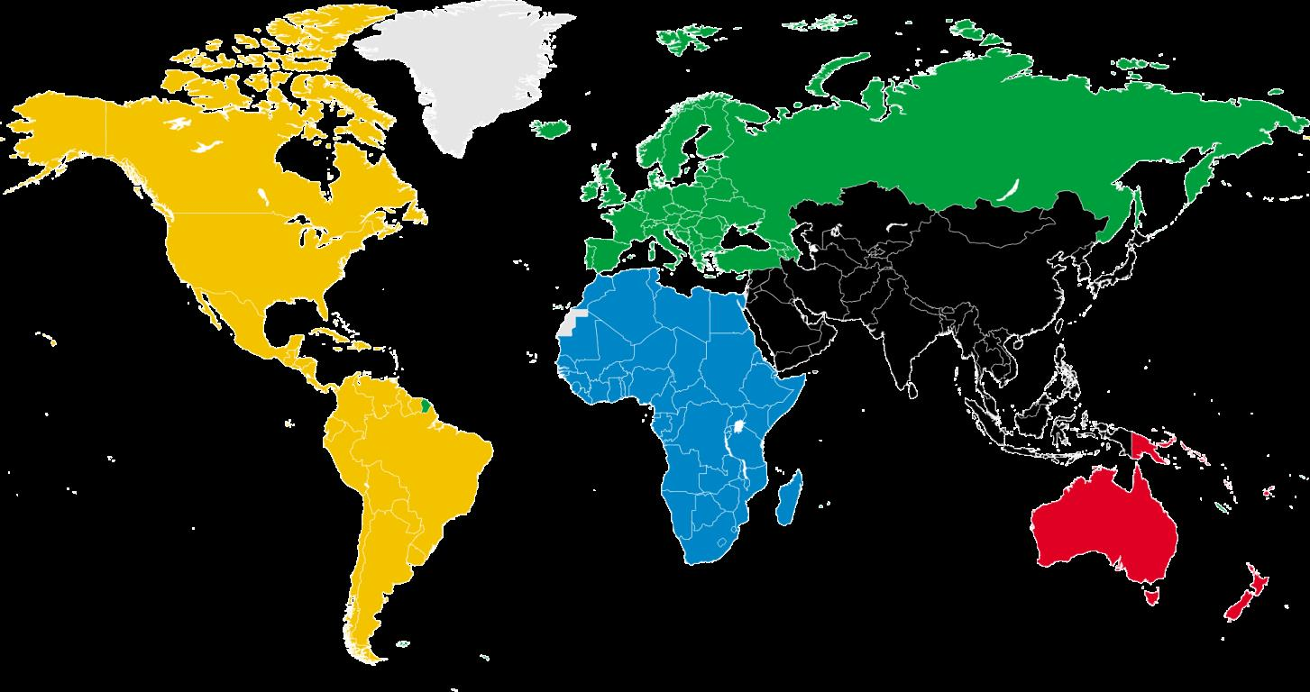
Where have your relatives or ancestors come from ?

Slide 3
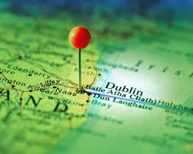
My family story :
My Father came from Dublin, Ireland in 1975
Push factor : His father was a doctor and didn't agree with being forced to perform abortions, as a family doctor.
Pull Factor : Canada was not asking family doctors to perform abortions so he would be able to keep practicing . Also, he wanted more opportunity for his 7 children.
My Mother came from Wisbech, England in 1962
Push factor : Her father was struggling with his mechanic business because the English economy was not doing well.
Pull factor: Canada was offering a great deal of business opportunities for immigrants in the early 1960's.

Slide 4
Where has your family come from ? Another country, another part of Canada?
Please list a PUSH and PULL factors that influence their mirgration:
PUSH factor:
PULL factor:

Slide 5
Create a list of PUSH and PULL factors. Why would someone want to leave their country for another country?
Push factor
Pull factor

Slide 6
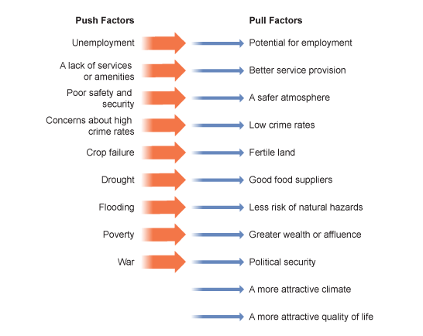
Push and Pull factors- why do people leave their country and why do they come to Canada

Slide 7
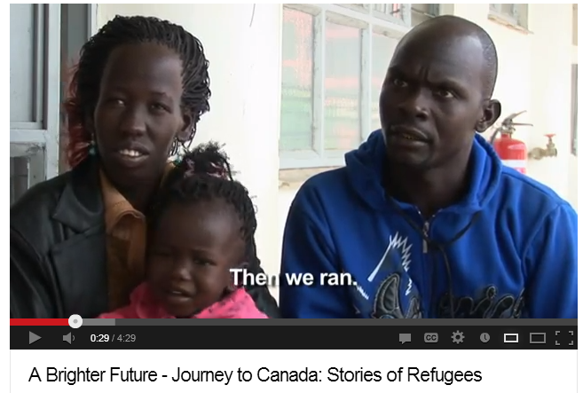
Watch the following clip and list the PUSH and PULL factors given by this Kenyan Family.

Slide 8
In a group of 5-6 students read and discuss the possible push and pull factors in the article you have been given.

Slide 9
Population :
All the people who share the same geographical space
Mortality rate
The number of deaths per 1000 inhabitants
Birth rate
The number of births per 1000 inhabitants
Fertility rate
The relationship between the total number of valuable births and the average number of women of childbearing age.
Population density:
The measurement of the number of inhabitants in a unit squared ( km ²)

Slide 10
Lesson 2

Slide 11
Sept 11/2013
Population and settlement
Lesson Objective
1. learn about population density, population growth and demographics in Quebec .

Slide 12
Population density:
The measurement of the number of inhabitants in a unit squared ( km ²)
= 1 person / 1km²
1 km
1 km

Slide 13
p 4 in your textbooks

Slide 14
Russia
http://www.gkstill.com/Support/crowd-density/625sm/Density2.html
1 km
= people / km²
1 km
Brasil
South Africa
1 km
= people / km²
1 km
= people / km²
1 km
1 km

Slide 15
Montreal
• Density | 4,517.6/km2
http://www.gkstill.com/Support/crowd-density/625sm/Density2.html
1 km
= people / km²
1 km
Quebec city
province of Quebec
1 km
= people / km²
1 km
= people / km²
1 km
1 km

Slide 16
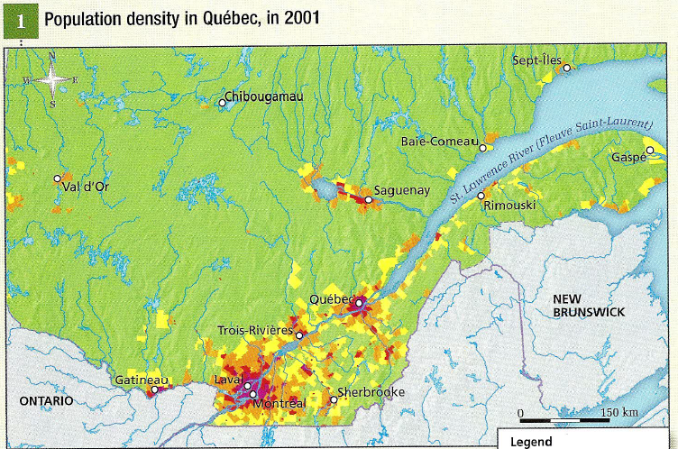
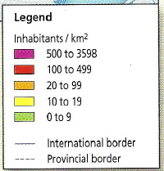
Quebec's population density
Which part of quebec has the greatest population density?
Describe the population density outside urban areas.

Slide 17
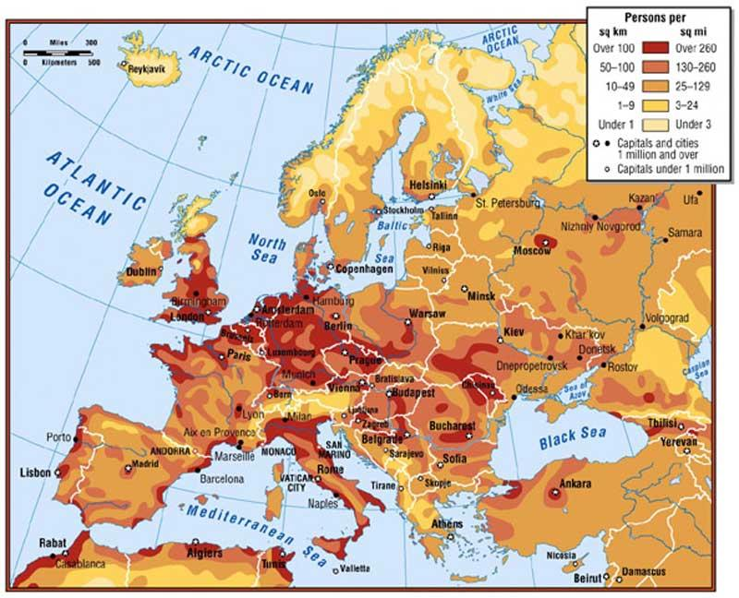
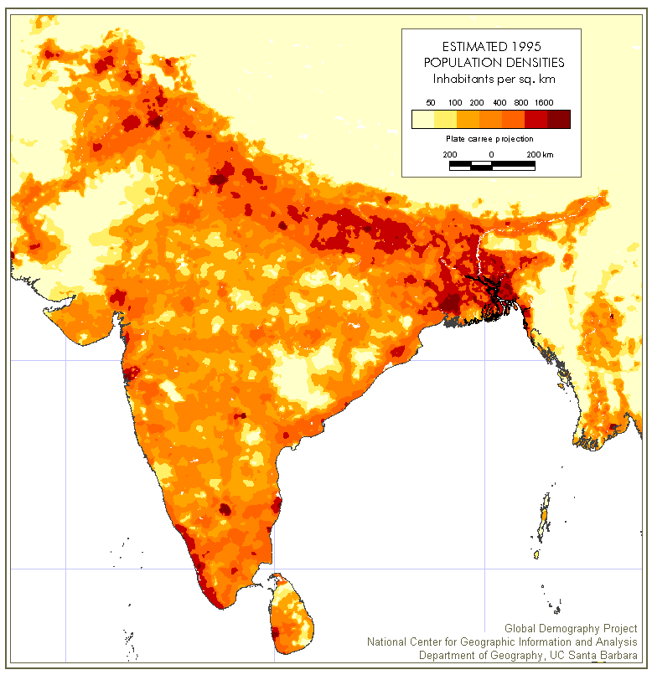
How does Quebec's population density compare with the rest of the world?

Slide 18
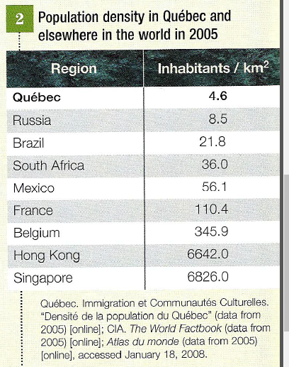
In your opinion why is Quebec so sparsely populated ?
Which country is most densely populated?

Slide 19
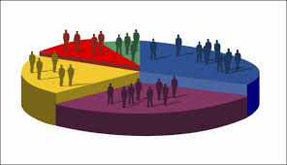
Demographics
·Elements of a population based on factors such as age, race, gender, religion, economic status, level of education, income level, employment, or language.
·Demographic trends are also important, as the size of different demographic groups will change over time as a result of economic, cultural and political circumstances.

Slide 20
How would we breakdown the Demographics in our class?
·Age
·Gender
·Economic status ( independent or dependent)

Slide 21
What are the Demographics of Canada today?
Estimate:
·The current population of Canada
·Current population of Quebec
·#1 self reported ethnic origin
·Current population of Aboriginal people

Slide 22
Demographic profile
·Population of Canada: 34.8 million
·Population of Quebec: 8 million
·#1 ethnic origin: Canadian (32%)
·Other ethnic origins: English (21%), French (16%), Scottish (15%), Irish (14%), German (10%), Italian (4%), Chinese (4%), First Nations (4%)
·Aboriginal Population: 1.1 million

Slide 23
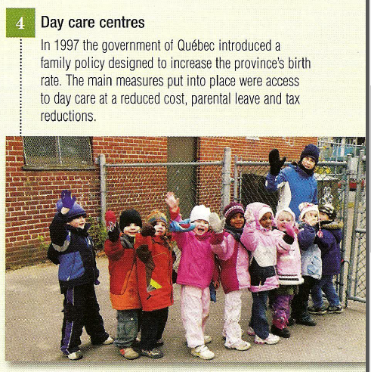
In order to understand population, people study natural growth and migration flows.
·Natural growth – difference between births and deaths. Or birth rate vs. death rate. The difference between these two determines if population goes up or down.
·Fertility rate: total number of births vs. the average number of women who can have babies. Right now that is 1.6 in Quebec, when the average should be 2.1 for population renewal.

Slide 24
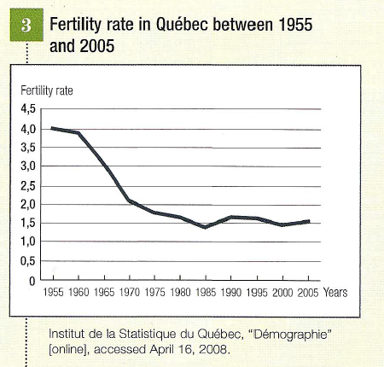
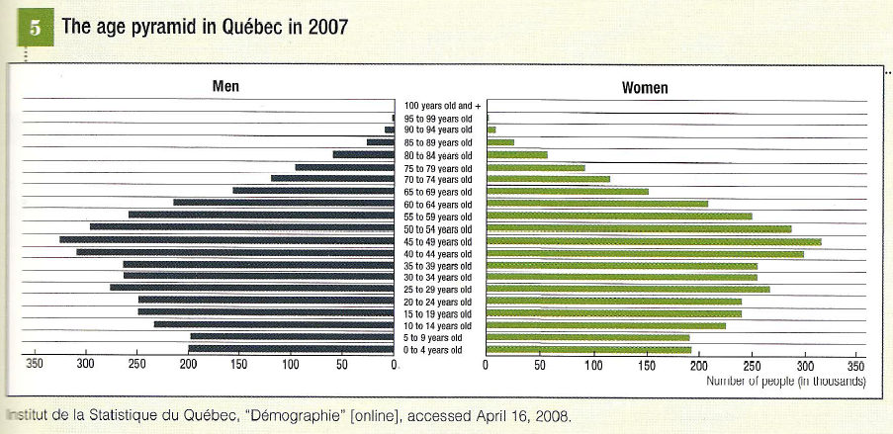
Natural growth
Quebec is also aging – and living longer. This is also not helpful in combating the potential for population decrease.
·Which is the largest population among men and women?
·In what decade did the birthrate begin to fall?

Slide 25
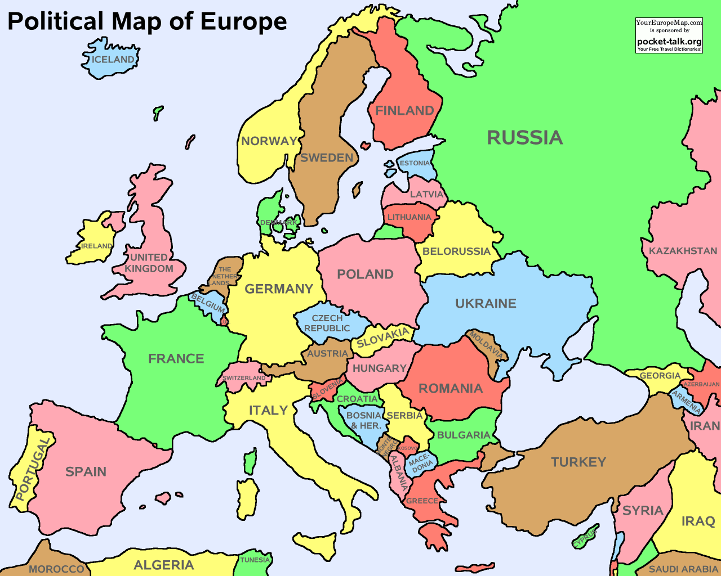
Homework: Geo quiz
due Friday sept 13
·You must place the following countries of Western Europe on a map:
·Ireland, Great Britain, Portugal, Italy, Germany, France, Belgium, Spain, The Netherlands

Slide 26
lesson 3

Slide 27
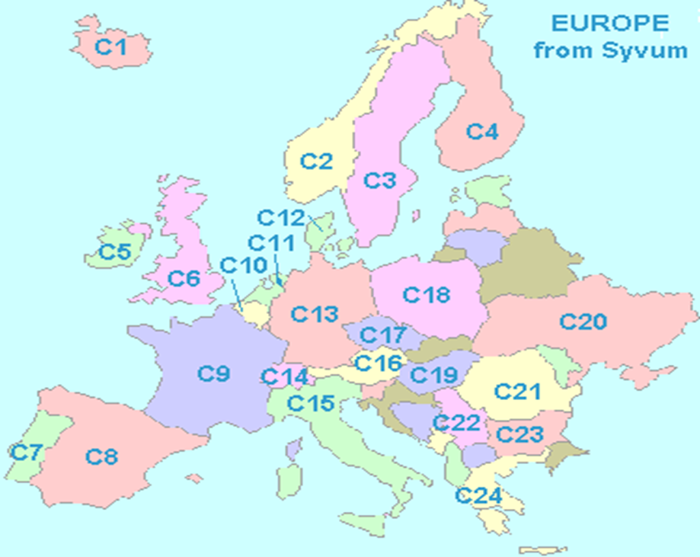
Geo Quiz
1.C5: ireland
2.C6:UK / england gb
3.C7: Portuagal
4.C8 spain
5.C9: france
6.C10: belgium
7.C11: the netherlands
8.C13: germany
9.C15: italy

Slide 28
On the same sheet, in your own words, describe :
Population density
push factor
pull factor
demographic
migration

Slide 29
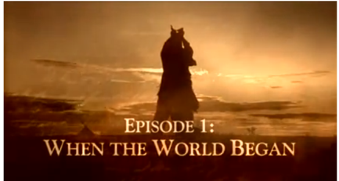
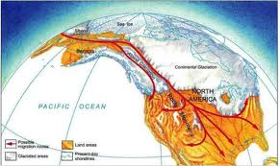
Go to page 10 and 11 in your textbook.
12:50 - 20:00

Slide 30
Bering Strait Land Bridge
·is widely accepted as the most probable migratory route of humans into the Americas.
·Geologists estimate that this land bridge formed 75,000 years ago and ended about 14,000 years ago.
·the landscape during the time of exposure would have consisted of a dry tundra plain environment; the climate might have been similar to the climate of present-day tundra or grassland Plains environments, with short summers, extremely long cold winters and perpetual winds.
·Remains of large mammals such as mammoth, and mastodon have been found, suggesting that the first North Americans were big game hunters
·Peoples then moved south into North America by following possible unglaciated routes along the pacific coastline or an Alberta corridor.

Slide 31
·.
·The oceans rose and the land bridge was entirely submerged.
·
·The thaw brought about climatic changes throughout the North American continent and diverse geographic regions were created.

Slide 32
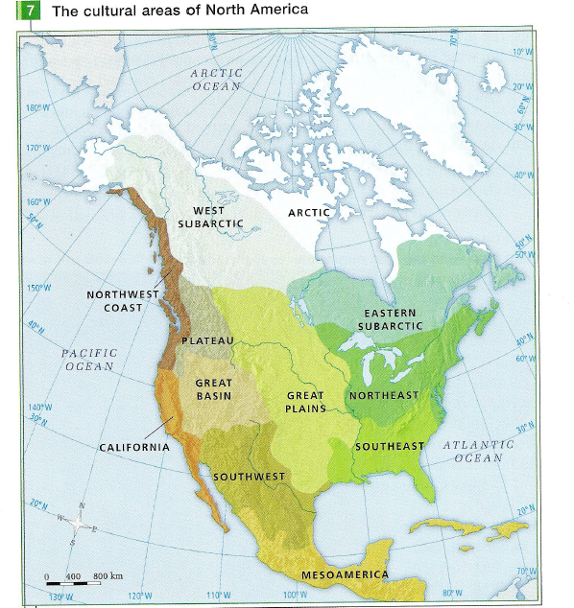

Slide 33
Describe the stages of the arrival of the first occupants in the territory of Quebec.
What are the names given to these stages?
Woodland
period
Archaic
period
Paleoindian
period

Slide 34
Describe the stages of the arrival of the first occupants in the territory of Quebec.
What are the names given to these stages?
Paleoindian
period
·10000- 8000 BCE
·The ice receded the environment became favorable to animals.
·Hunter gatherer groups from the south moved into the territory of Quebec to hunt caribou and eventually other types of animals( seal. hare, fish)
Archaic
period
·8000-1000 BCE
·Environment became more stable ( climate, vegetation, lakes and rivers
·Migration became seasonal, they had more resources where they were.
·Population increase.
·communication networks established ( goods traded by other tribes)
·they began to make more specialized tools ( hunting and sewing)

Slide 35
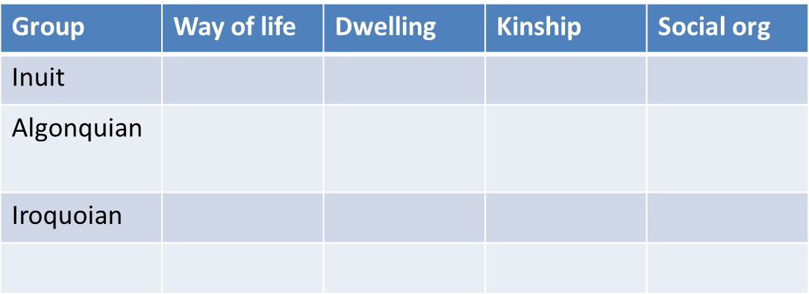
Woodland
period
·1000 BCE- 1500 CE
·three major innovations transformed daily life
·the bow and arrow : improved hunting techniques
·pottery : allowed food to be cooked
·agriculture: lead to sedentary living ( staying one place) which lead to a population increase.
·as a result villages grew.
3 Cultural Groups in Quebec
1. Copy the map on page 16 (Aboriginal groups in Quebec and geographic regions)
2. Create and fill in this chart: (pgs 17-19)

Slide 36
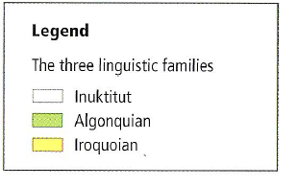
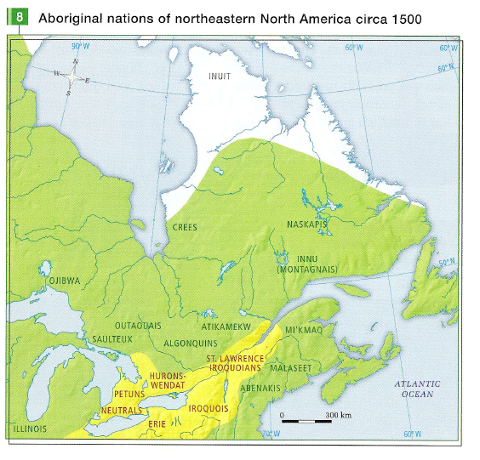
Please copy, color and label the following map with a legend onto the blank copy of Quebec.

Slide 37
Population Quebec, circa 1500
·At this time Aboriginal peoples each had their own beliefs, languages and ways of life.
·They were divided into three linguistic groups:
·Iroquoian, est. between 5,300 to 10,100
·Algonquin, est. between 12,000 to 20,600
·Inuktitut, est. between 1,000 to 5,000
·Why the discrepancy between the min and max?

Slide 38
·Iroquoian:
·Way of life : Social and Political organization became more complex when they became semi-sedentary.
·Dwelling: longhouses, grouped in a village, surrounded by palisade, close to water and on fertile ground.
·Kinship: passed through the mother, instead of father.
·Social Organization: clan->village->nation->confederation
·Political Representation:
·Exercise of Power: group consensus, power positions appointed by female elders
·Civil Chief: hereditary position, kept civil order in the village, related to other villages
·Council: association of clan chiefs, at all levels
·War Chief: temporary, chosen for bravery

Slide 39
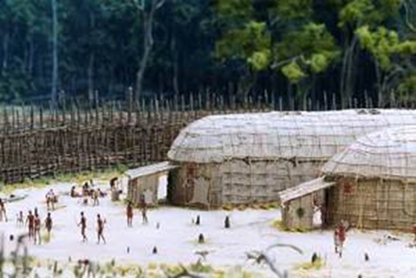
·Look at document 24 on page 17: What does this document tell you about Iroquoian social organization?

Slide 40
The Algonquians:
·Way of life :Moved perpetually for resources (nomads).
·Dwelling: lived in wigwams (animal skin or bark)
·In summer, many close together and to water
·In winter, smaller groups, further inland.
·Kinship: lineage father to son
·Social Organization:
·Nuclear family: More than one family would live in a wigwam.
·Hunting group: Small groups of few families would hunt together in winter.
·The Band: Large group who stayed together for the summer.
·Political Representation:
·Exercise of Power: by consensus.
·Band Chief: temporary position, chosen by quality of hunting skills

Slide 41
Inuit:
·Way of life : Nomadic.
·Dwelling: animal hide tent in summer, Igloo in winter.
·Kinship: father to son.
·Social Organization:
·Nuclear family: very flexible organization.
·Hunting Group: small groups related family or friends.
·Regional band: several families together.

Slide 42
·What were the effects of migrations and the growth of Aboriginal populations on the organization of their societies? (summary/analysis question)
migration - people moving around - how did that change the number of aboriginals living in a particular territory.

Slide 43
Answer :
The effects of migration on the growth of aboriginal population was:
1. that were constantly on the move and because more of them shared the territory.
2. they established trade relations and occasionally confronted each other in armed conflicts.
The population growth of aboriginal peoples led them to:
1. Gather together in hunting groups, bands and clans, in the case of the Iroquoians, to found villages.
2.This growth also led to the development of a political structure.
3. In addition to establishing complex political systems with chiefs and a council, certain nations belonging to the Iroquoian family also formed a league or confederation.

Slide 44
·Answer :
·The effects of migration on the growth of aboriginal population was that were constantly on the move and because more and more of them shared the territory, the different families and aboriginal nations that occupied the territory of present day Quebec came into contact, established trade relations a occasionally confronted each other in armed conflicts.
·The population growth of aboriginal peoples led them to gather together in hunting groups, bands and clans, in the case of the Iroquoians, to found villages. This growth also led to the development of a political structure. In addition to establishing complex political systems with chiefs and a council, certain nations belonging to the Iroquoian family also formed a league or confederation.

Slide 45
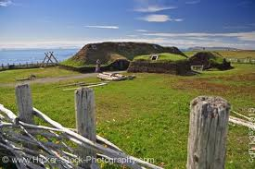
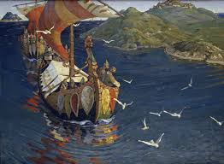
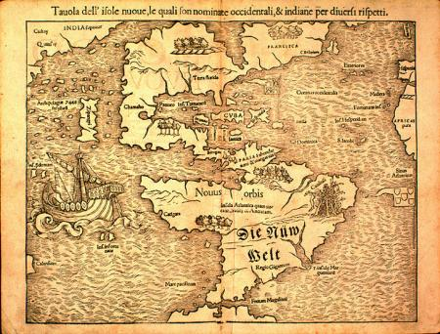
Arrival of the Europeans
·Other Europeans had reached North America before the French – for resources and to scout.
·Scandinavians arrived in 1000 – stayed only 2/3 years as they were driven out by Aboriginal.
·In 1500, Europeans searched a new trade route to Asia – without success. They did notice large fish stocks off the coast of Newfoundland.

Slide 46
http://www.youtube.com/watch?v=gRi-UWi3Hsg
0-3mins

Slide 47
How did Cartier and Roberval attempt to create a settlement?
Were they successful? Explain why or why not ?
What was the most likely cause of the disappearance of the St Lawrence Iroquoians?
due friday read pg 21-22

Slide 48
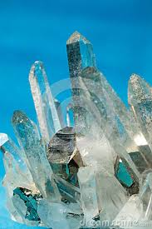
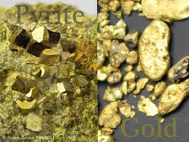
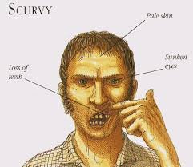
How did Cartier and Roberval attempt to create a settlement?
·Cartier and Roberval attempted to create a settlement however it failed.
·Cartier was hired to help Roberval settle a total of 700 settlers in Stadacona ( qubec city).
Were they successful? Explain why or why not ?
·They were not successful at creating a settlement because
·Cartier however wanted to return to france with his 'gold and Dimonds ( fools gold and quartz)
·The little community of 700 settlers was hit by a harsh winter , food shortages and scurvy.
Roberval later left to return to france.

Slide 49
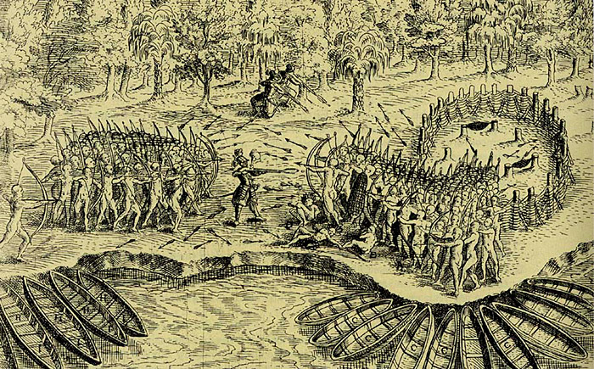
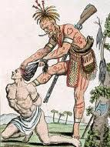
What was the most likely cause of the disappearance of the St Lawrence Iroquoians?
The most likely cause of the dissaperance of the st lawrence Iroquoians was because of an increase in conflicts with other aboriginal nations. THe iroquian were the europeans prefered tribe to trade with so this cause tensions with other tribes.

Slide 50
How did France attempt to settle people in New France and make the population grow?
Cartier and Roberval attempt to settle Stadacona (Quebec city).
Champlain founding of New France - Quebec city
1680
1700
1740
1760
1530
1540
1608
1620
1640
1660

Slide 51
What is the difference between 1600's ( sixteen hundreds) and 16th century?
1600's = 1600 to 1699
16th century = 1500-1599
1500's
1600's
1700s
1800's
100's
1500
1600
1700
1800
1900
centuries
16th century
17 century
18 th century
19th century

Slide 52
Cartier & Roberval
·Most European countries were building colonial empires. France wanted to be competitive.
·In 1534/1535 Jacques Cartier was ordered twice to find a suitable northwest passage.
·He found no precious metals, but good land for agriculture and stories from the Hochelaga people.
·Cartier returned in 1540 and settled in Stadacona.
·Returned to France with ‘gold’ & ‘diamonds.’
·Roberval stayed on, but was forced out by climate and food shortage.
·France considered the territory their due to the crosses that were planted.

Slide 53
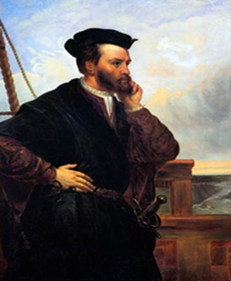
Jacques Cartier
·A French navigator.
·Was sent by the King of France, François I, to the New World to discover gold and diamonds and a new route to Asia.
·Explored what became known as Newfoundland.
·The first explorer to map the St. Lawrence River.
·Discovered Prince Edward Island in 1534.
·Built a fort at Stadacona, where Quebec City is now located.
·Further up the St. Lawrence, he had Indian guides lead him to Hochelaga (Montreal).

Slide 54
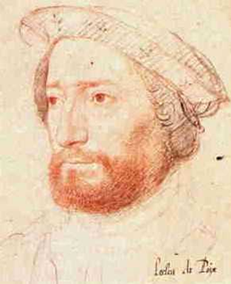
Jean-Francois De LaRocque De Roberval
·Francis I of France gave Roberval a commission to settle the province of Canada and provide for the spread of the "Holy Catholic faith".
·Jacques Cartier was hired to help, and was given Cartier to proceed to New France. Cartier did so in May 1541, and, with 500 colonists, built a fortified colony.
·Roberval with his three ships and 200 colonists set sail in April 1542, arriving June 8. Cartier, impatient to show the king the "gold and diamonds" he had found was already on his way home from Charlesbourg-Royal.

Slide 55
Class Work/Homework
·Read pages 26-27.
·Interpretation Question 1 to 4.

Slide 56
What were the diferent methods used by the french to occupy the terrtory?
The different meathods used to occupy the territory were the seigneurial system, the fur trade, exploration and the building of forts and religious missions to convert the aborigonals.
What allowed cities and villages to grow?
the factors that allowed cities and villages to grow were commercial activity ( the buying and selling of goods) and a high number of births.
What are the consequences of exploration on the territory?
the consequences of exploration was that many single men didn;t want to settle the land, but instead wanted to explore, join the fur trade, evangelize to the aboriginals about God or simply wanted adventure
What impact did the occupation of part of the territory by the english have on the french?
the impact of the british occupying territory was that
competition for the french trading networks
- this led eventually to wars which resulted in parts of the New france territory being given over the british.

Slide 57
seigneurial
system
fur trade and exploration
evangelism of the christian faith

Slide 58
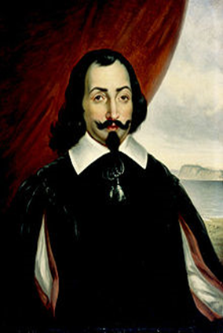
Samuel de Champlain
·Navigator, explorer, cartographer.
·“The Father of New France.”
·He founded New France and Quebec City in 1608.
·Made the first accurate map of the coast and he helped establish the settlements.
·Was the first European to explore and describe the Great Lakes, he formed relationships with local Aboriginal groups (Algonquin) and agreed to provide assistance in their wars against the Iroquois.
·1620: Louis XIII ordered him to administer the country (essentially becoming Governor, though was not a noble).
·He established trading companies that sent goods, primarily fur, to France, and oversaw the growth of New France in the St. Lawrence River Valley until his death in 1635.

Slide 59
Occupation of the Territory
·Colonization began in earnest in the early 1600’s.
·Expeditions and exploration led France to ‘control’ the area (based on trading posts).
·Entrepreneurs were granted monopolies – who agreed to establish colonies and evangelize the Aboriginal populations.
·In 1608, Champlain settled in Quebec City – a location known by Europeans and good for commerce (trading with Aboriginal groups).
·Despite renewed interest in settlement of the area, growth of Quebec City was slow.
·It was not until the 1630s that the population was over 100.

Slide 60
continue with french settlers updated ppt

